Slide 1
6.885 Class 1
Sam Madden

Slide 2




Administrivia
Course Staff:
Sam Madden
Amol Deshpande
Adam Marcus
Eugene Wu
Contact us at: 6885-staff@mit.edu
Website: http://db.csail.mit.edu/6885/
https://github.com/mitdbg/asciiclass
First Lab Due Monday

Slide 3
Interactive Large-Scale Visualization using a GPU Database

Slide 4
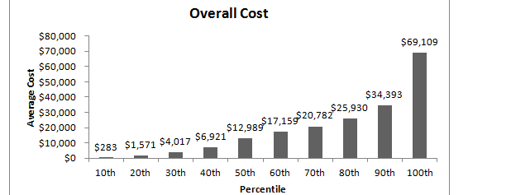
The Need for Interactive Analytics
DataHub needs to support browsing massive data sets
Browsing is best supported through visualization
➔ ad-hoc analytics, with millisecond response times

Slide 5
MapD: GPU Accelerated SQL Database
Key insight: GPUs have enough memory that a cluster of them can store substantial amounts of data
Not an accelerator, but a full blown query processor!
Massive parallelism enables interactive browsing interfaces
4x GPUs can provide > 1 TB/sec of bandwidth
12 Tflops compute
Order of magnitude speedups over CPUs, when data is on GPU
“Shared nothing” arrangement
Notes:
----- Meeting Notes (8/27/13 11:58) -----
improvements -> speedups

Slide 6
Demo

Slide 7
